Slide 1
AGILE METHODOLOGY and GitLab
Done by
K.Shivani(CSE(aiml)
M.Lavanya(ECE-3b)
M.Vivek Reddy(ECE-3b)
M.Manideep(CSE-3b)
S.Chenna Rao(ECE-3c)

Slide 2
Content:-
Agile
Principles of Agile Manifesto
Agile pros and cons
When should you use Agile project management
Agile methodologies & frameworks
GitLab
key features of GitLab

Slide 3
Agile:-
Agile is an approach to project management that centers around incremental and iterative steps to completing projects. The incremental parts of a project are carried out in short-term development cycles. The approach prioritizes quick delivery, adapting to change, and collaboration rather than top-down management
In Agile processes, there is constant feedback, allowing team members to adjust to challenges as they arise and stakeholders an opportunity to communicate consistently.

Slide 4
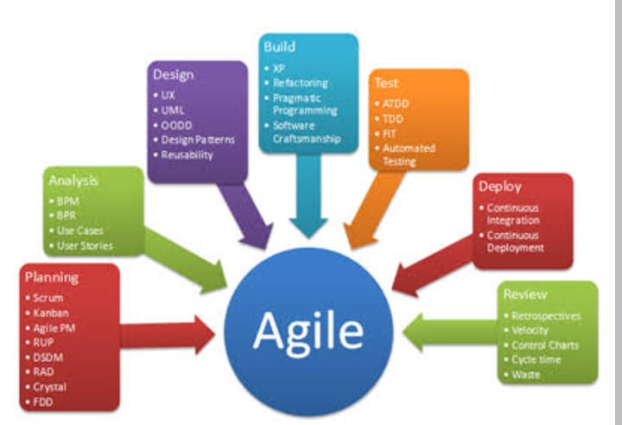
Agile:-

Slide 5
Principles of Agile Manifesto:-
There are 12 principles in Agile Manifesto:
Meeting end users' needs with early and Assembling a motivated team, providing them with the right environment and support, and trusting them.
Communicating face-to-face regularly continuous delivery of work.
Being open to changes in requirements even late in the project.
Delivering completed work at regular intervals, preferably short ones.
Working with the project team and business owners daily.

Slide 6
.
Using completed work to measure progress.
Creating processes that promote sustainable efforts and a constant pace of work.
Requiring continuous attention to excellence through good design.
Encouraging simplicity.
Recognizing that the best work emerges from self-organized teams that deliver the best architectures and designs.
Reflecting regularly on how the team can be more effective and fine-tuning and adjusting the approach.

Slide 7
.
The Agile Manifesto of Software Development put forth a groundbreaking mindset on delivering value and collaborating with customers when it was created in 2001. Agile’s four main values are:
Individuals and interactions over processes and tools
Working software over comprehensive documentation
Customer collaboration over contract negotiation
Responding to change over following a plan

Slide 8
Agile pros and cons
Agile benefits: Agile challenge:
increased project visibility >> Organizations can resist change
Improved business/IT alignment in adoption
Delivery speed/time to market >> Needs support of leadership
Ability to manage changing priorities and management
>>Teams may use inconsistent
practices

Slide 9
When should you use Agile project management
The tenets of agile adaptability, iteration, continuous delivery, and short time frames, among others make it a project management style that’s better suited for ongoing projects and projects where certain details aren’t known from the outset. That means if a project doesn’t have clear constraints, timelines, or available resources, it’s a good candidate for an Agile approach.
For example, designing and launching a new product might push a team against several unforeseen challenges. Having an Agile approach can mean the project already has the methodology to test products as often as needed, iterate quickly, and communicate changes with stakeholders.

Slide 10
Agile methodologies & frameworks
There are several Agile methodologies and frameworks, each with its own pros and cons. Some are hybrids of multiple methodologies. Scrum is the most commonly used Agile methodology. Digital.ai found that 66 percent of Agile adopters used Scrum, with the next most-used methodology being ScrumBan, at 9 percent .
Popular Agile methodologies include:
Scrum
Kanban
Lean
Crystal
Extreme Programming (XP)
Feature-Driven Development (FDD)
Domain-Driven Design (DDD)
ScrumBan
Agile-Waterfall/Hybrid Agile
Scrum XP Hybrid

Slide 11
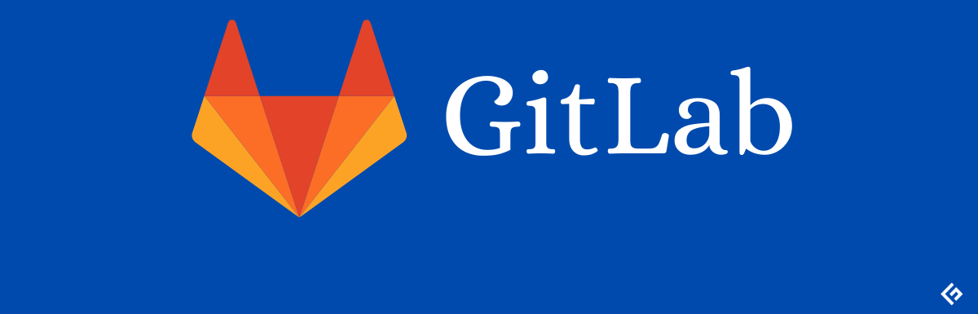
GITLAB
GitLab is a web-based DevOps platform that provides a complete set of tools for version control, continuous integration/continuous deployment (CI/CD), project management, and more. It offers a centralized repository for managing source code, collaboration features, and an integrated pipeline for automating software development processes.

Slide 12
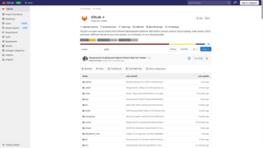
.
There are some key features and concepts associated with GitLab:
Version Control: GitLab uses the Git version control system, allowing teams to track changes to their source code and collaborate effectively. It supports all Git functionalities, including branching, merging, and history tracking.
Git Repository Management: GitLab provides a centralized repository management system where you can create, clone, and manage Git repositories for your projects. Each project has its own repository, allowing you to keep code organized and accessible.
Issue Tracking: GitLab includes an integrated issue tracking system that enables teams to manage and track bugs, feature requests, and other tasks related to a project. Issues can be assigned to team members, labeled, and organized using milestones, making it easier to track progress and collaborate on problem-solving.

Slide 13
..
Code Review and Collaboration: GitLab provides tools for code review, including the ability to leave comments, suggest changes, and have discussions on specific code snippets or files. This facilitates collaboration among team members, ensuring code quality and knowledge sharing.
Project Management: GitLab offers project management features like kanban boards, milestones, and time tracking. These tools help teams stay organized, plan work, and track progress on projects.

Slide 14
.
Security and Access Control: GitLab includes features to manage user roles and access permissions

Slide 15
.
Thank
you

